Slide 1

Reverse Engineering of an Ad
by NITHYASREE N

Slide 2
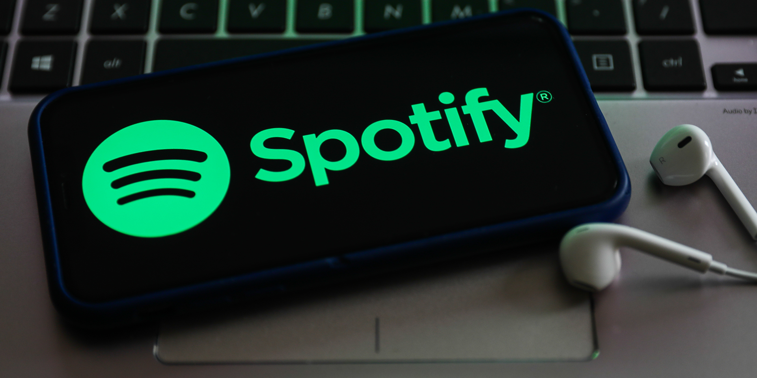

Slide 3

Spotify is a music streaming service originally founded in 2006 in Sweden.
The platform can be used from various devices and allows users to browse through a catalogue of music licensed through multiple record labels, as well as creating and sharing playlists with other users.
Additionally, listeners are able to enjoy music for free with advertisements or are also given the option to purchase a subscription to allow for unlimited ad-free music streaming.

Slide 4
TARGET AUDIENCE:
Millennials : 25-34 yrs
Gen Zs : 18-24 yrs

Slide 5
HYPOTHESIS TESTING:
Ho: Frequent listeners are millennials and gen z
H1: Users of all age are frequent listeners
Y= listeners/non listeners( Discrete)
X=Age group (Discrete)
Note: Hypothesis test used: CHI SQUARE Test

Slide 6
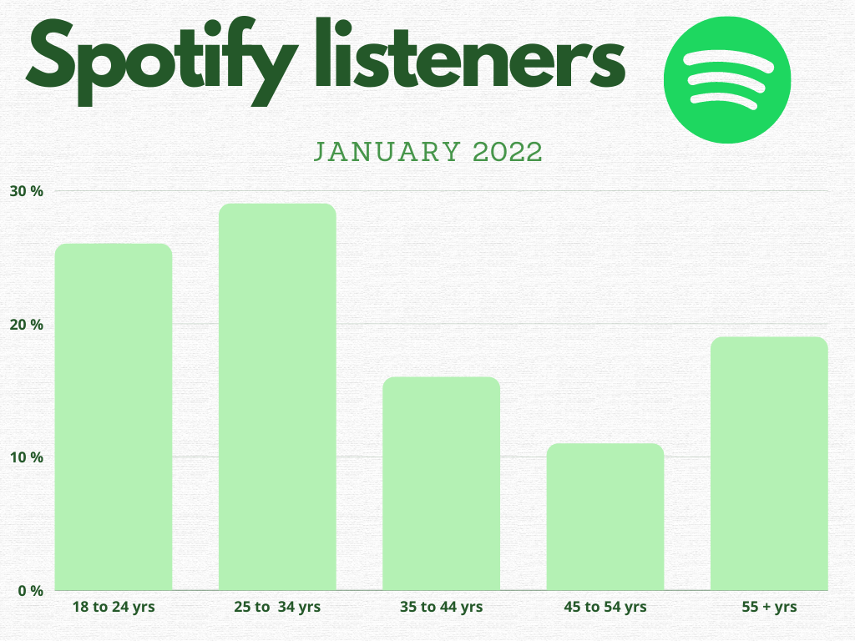

Slide 7
INFERENCE:
Spotify’s user base was dominated by Millennials, with 29 percent of its users aged 25 to 34 and they listens to music for about 28,653 minutes
26 percent aged between 18 and 24 years old and they listen for about 26,719 minutes.
Adults of age 35-44 years are not as frequents as millennials and Gen Zs and they listens to music for about 16,667 minutes
While aged adults 55+years listens to music more frequently for about 22,693 minutes

Slide 8
RESULT:
We inference that,
Our Ho is accepted. The most frequent listeners are Millennials and Gen Zs.
We also inference that the advertisement has attracted its target audience.
From the above graph we infer that the aged adults of 55+ years also uses Spotify, So we can include them as our target audience in the upcoming ads.

Slide 9


